Slide 1








Bonded CRCP Overlay on Jointed Concrete Pavement Design System

Slide 2
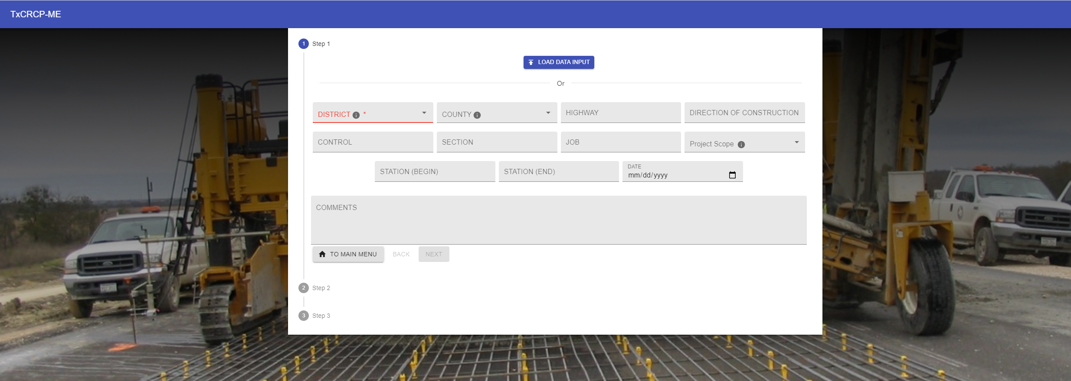

Slide 3
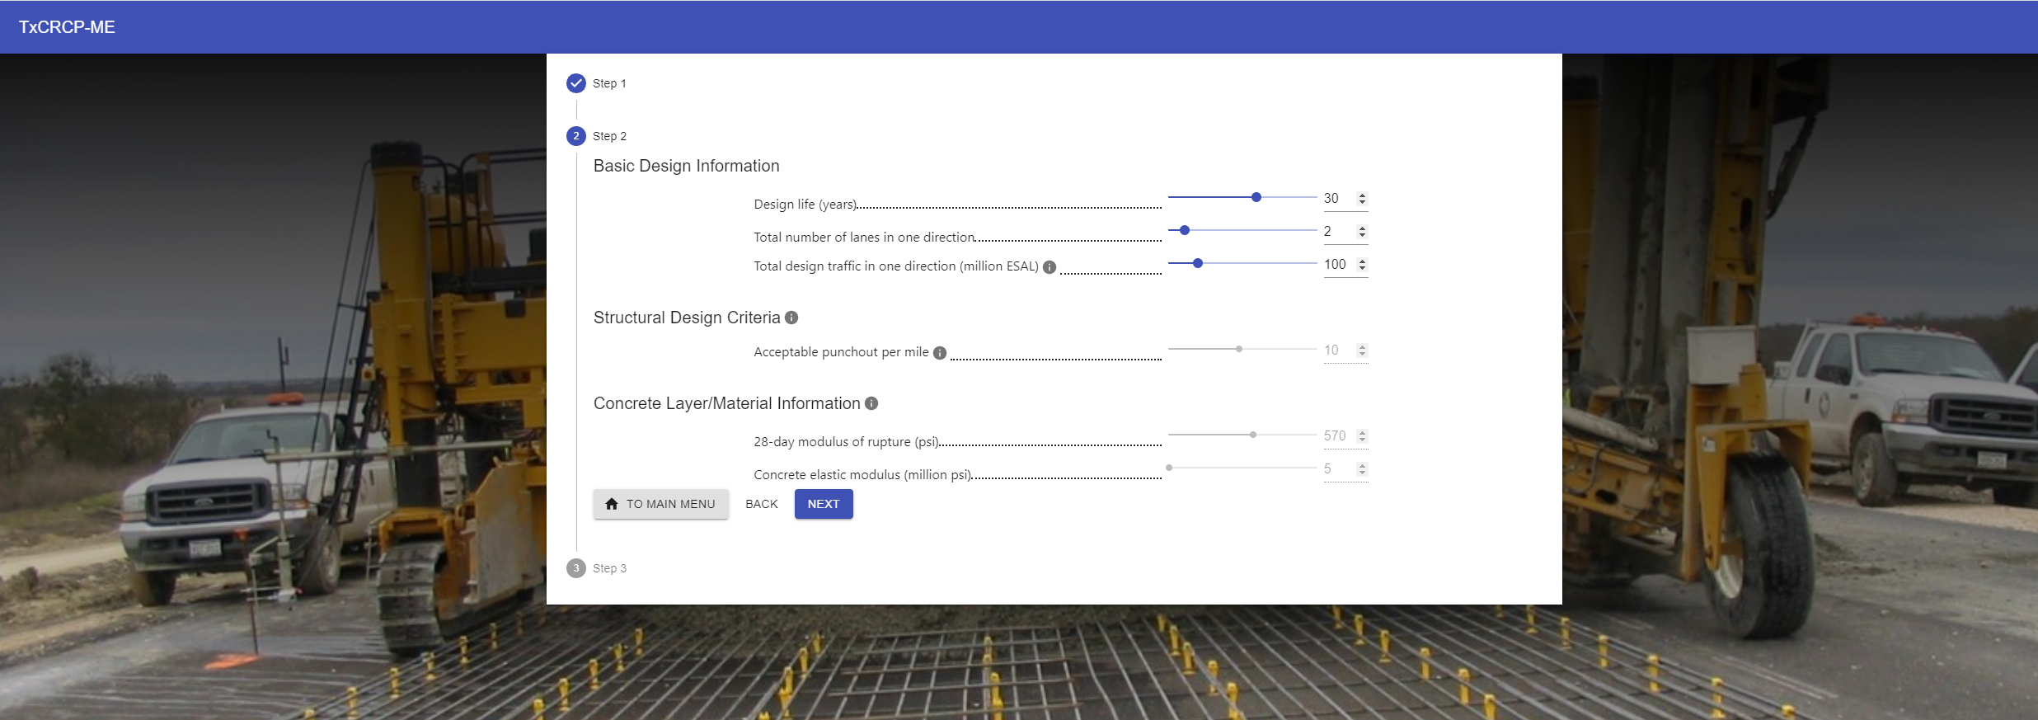



Slide 4
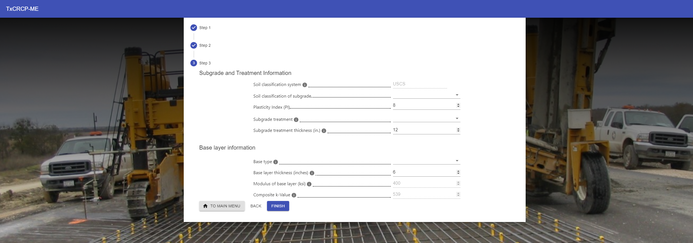

Slide 5
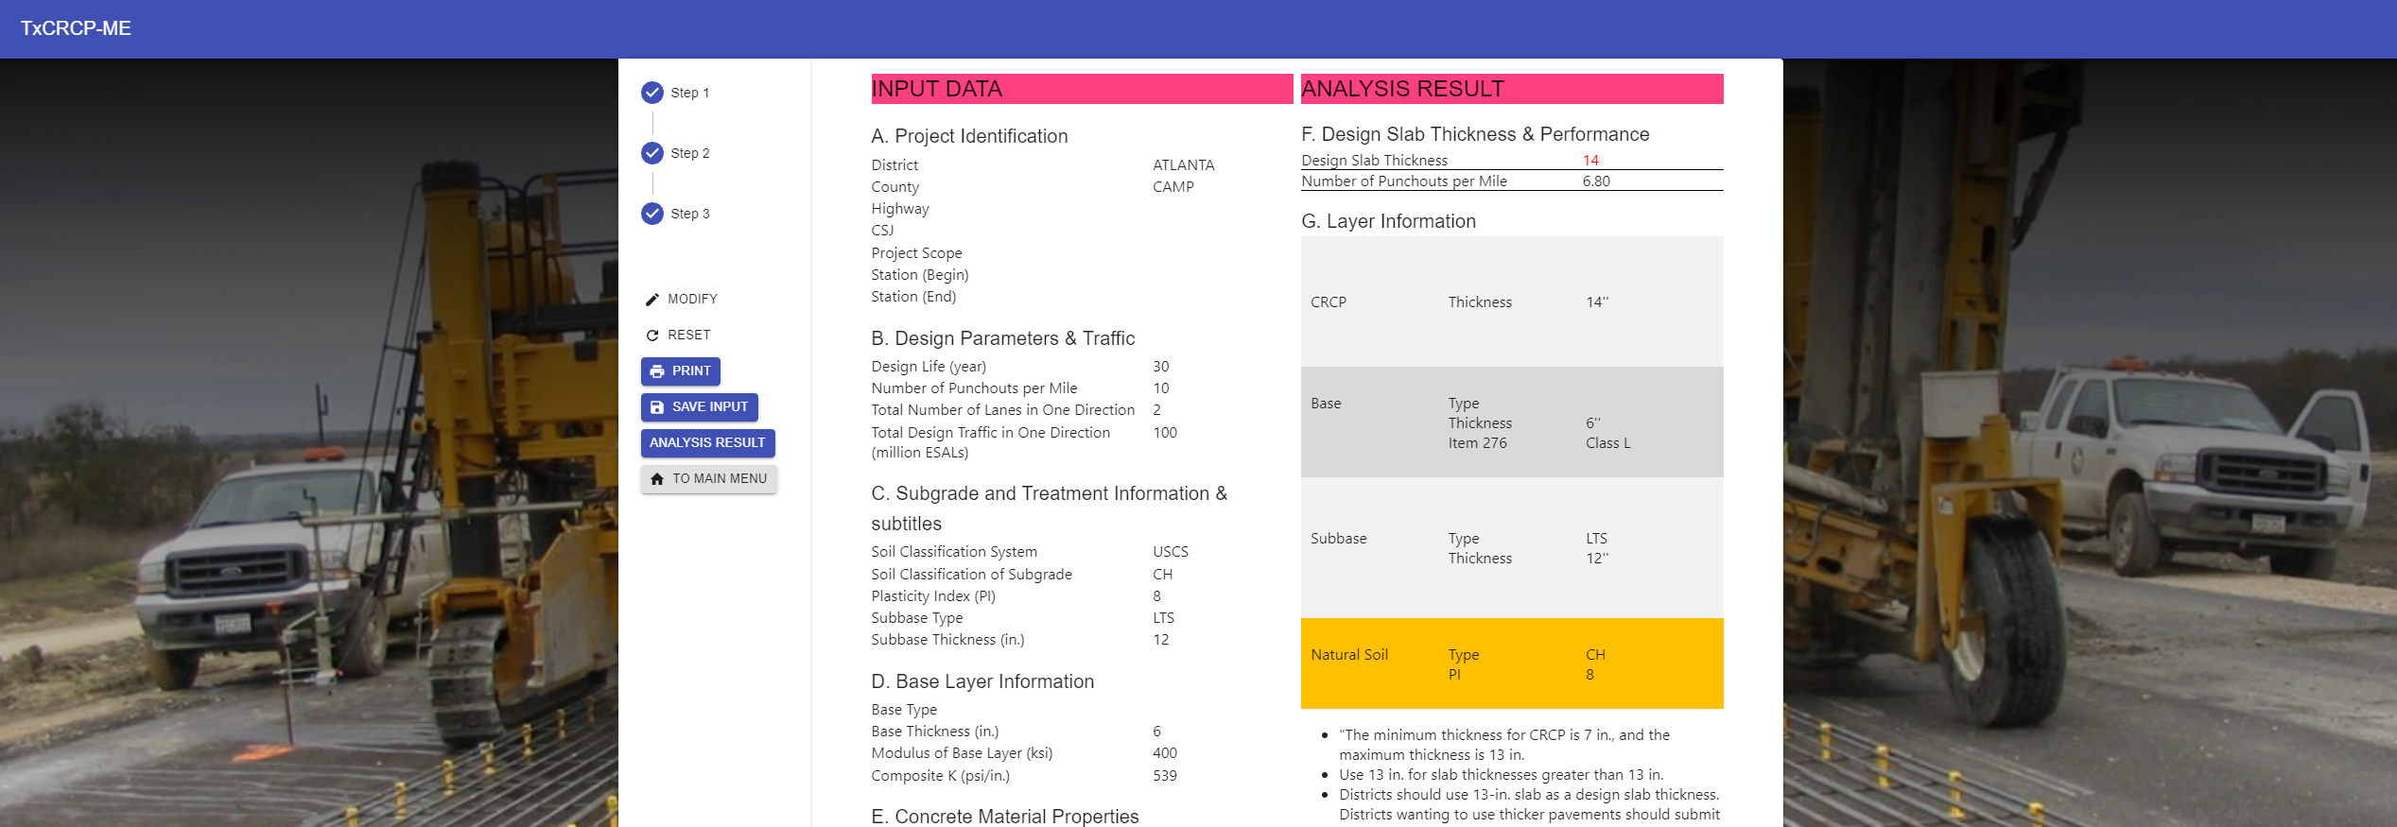






Overlay Design

